Slide 1
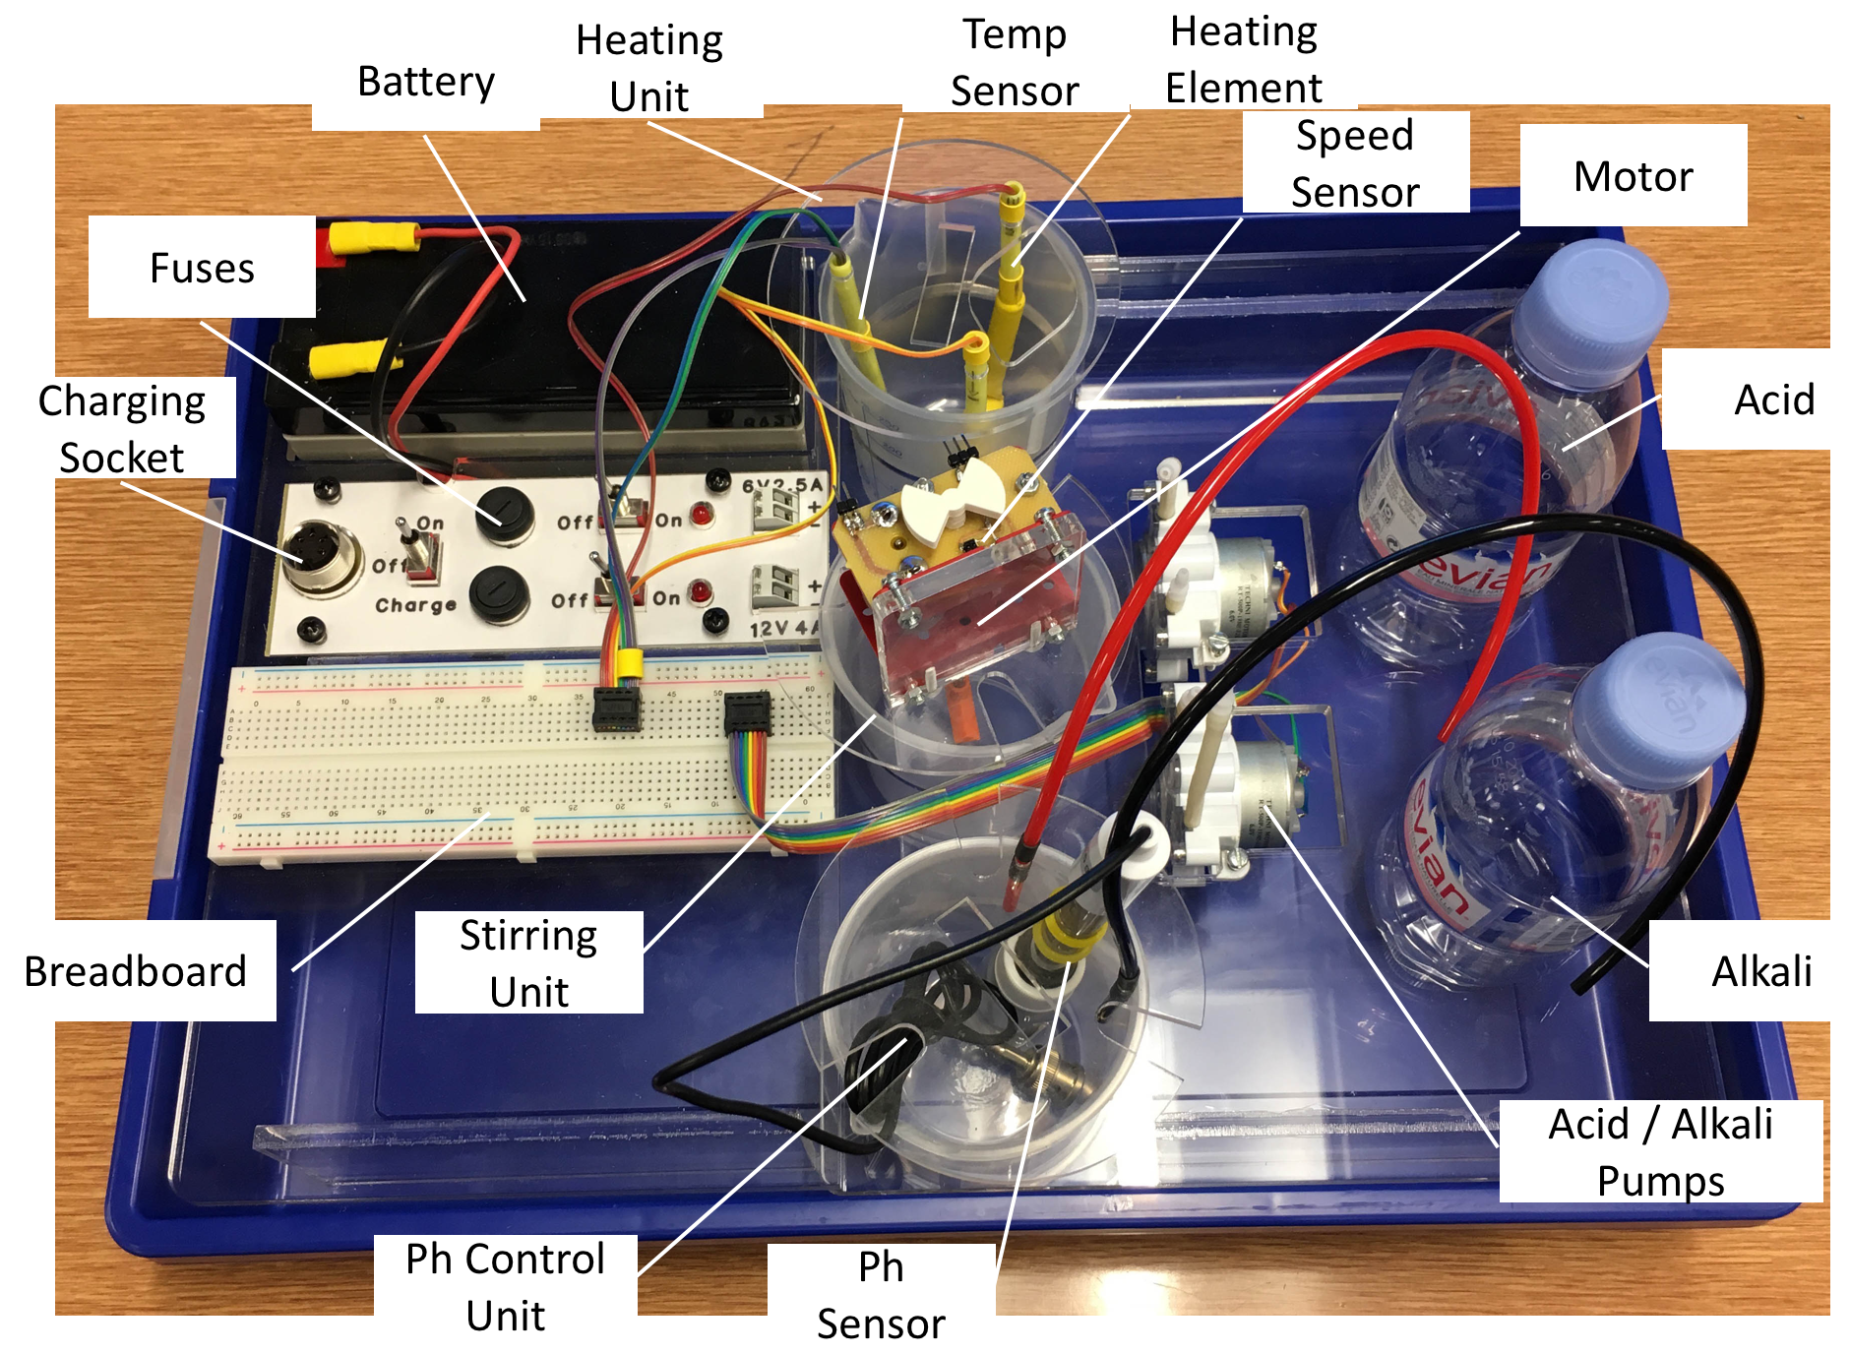
Bioreactor Systems Control

Slide 2
Design Process
Broke down task into subsystems and allocated members to each subsystem
Drawing of high level block diagram of overall task
Drawing of block diagrams for specific subsystems
Design of circuit board layouts and writing pseudocode
Implementation of circuits and code
Testing and modification of circuits and code to fit our technical specification.

Slide 3
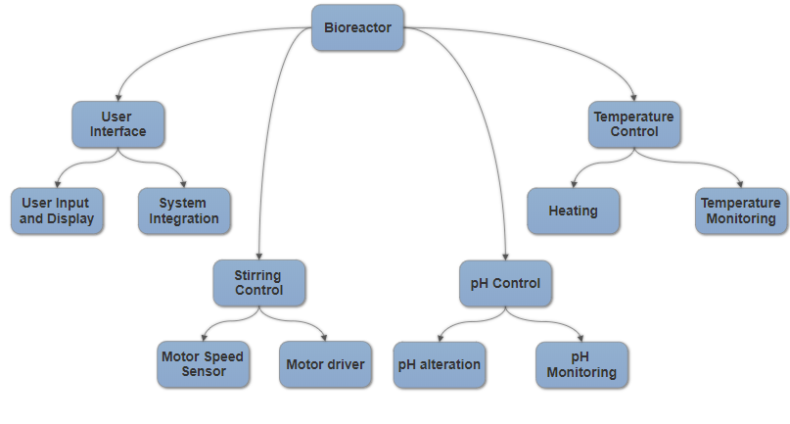
Overall System Block Diagram

Slide 4
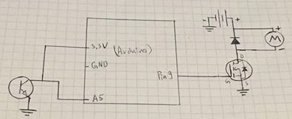
Stirring System – the circuit
Opposite is our circuit diagram
We needed to implement a circuit rather than driving the motor directly from the Arduino as the motor pulls too much current
The Arduino was however directly used to supply the photoresistor with 3V

Slide 5
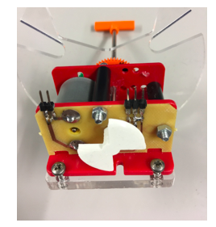
Stirring Control – motor speed sensor
Used a phototransistor and a piece attached to the motor
For every motor rotation the piece interrupts the phototransistor twice
Count number of interrupts in two seconds, divide by two, then multiply by 30 to calculate the current RPM.
Interrupt determined by a
change in voltage output by
the phototransistor
Stirring element
Motor
Plastic piece

Slide 6
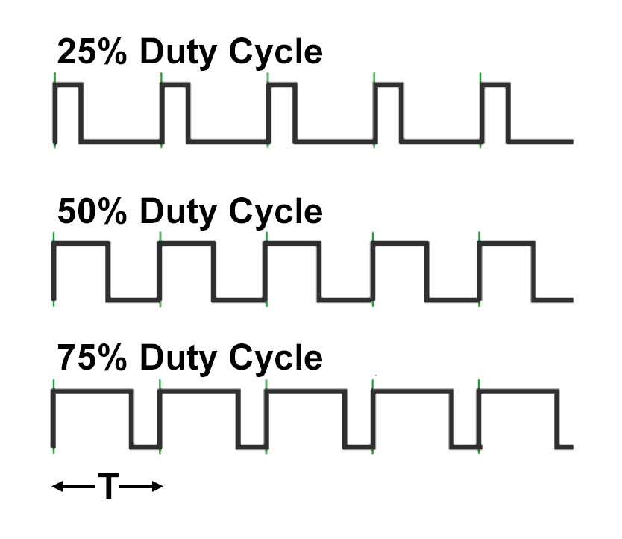
Stirring Control – driving the motor
Used Pulse Width Modulation (PWM) to increase or decrease motor speed
Calculated RPM value is compared against required RPM
Specification states accuracy required to be within +- 20 RPM for range of 500 – 1500 RPM
If RPM greater than upper threshold then PWM value is lowered
If RPM lower than lower threshold then PWM value is increased
PWM has a range of 0-255 and an increment of 2 was decided through testing time taken to reach target RPM

Slide 7
Stirring Control – data and test results
Range of acceptable values at 700 RPM was 680-720
Range of acceptable values at 1000 RPM was 980-1020
RPM reaches required value and may oscillate within accepted range (blue)
RPM also occasionally drops below required value only to then self correct itself (red)
RPM consistently increases at the start regardless of required RPM (green)
Revolutions Per Minute (RPM) Required RPM set to 700
870
930
840
750
690
720
690
690
720
660
720
Revolutions Per Minute (RPM) Required RPM set to 1000
870
1140
1080
990
990
990
990
1020
960
990
990

Slide 8
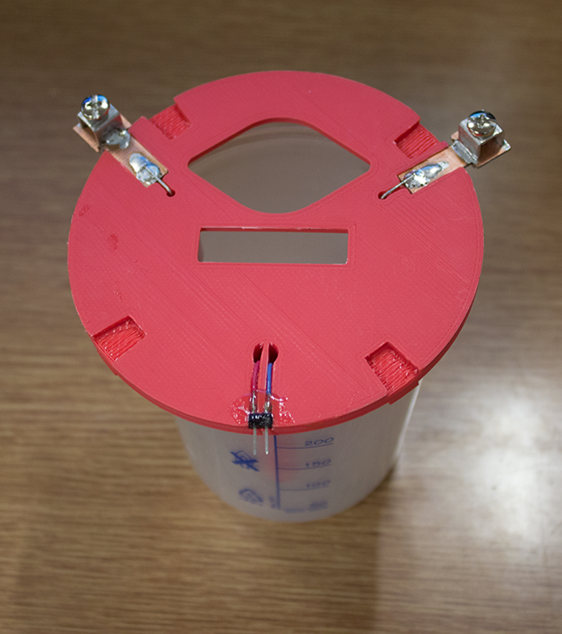
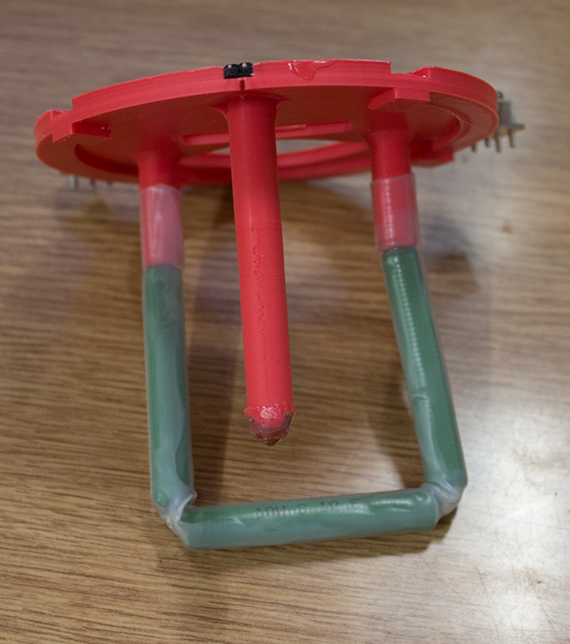
Temperature Control Subsystem
Thermistor
Heater

Slide 9
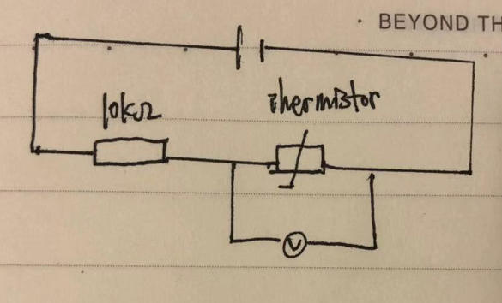
Temperature Control – Thermistor
5V Power supply
A 10kΩ NTC Thermistor (ND06P00103K)
A 10KΩ resistor
T=B/(ln(R/R0)+B/T0)

Slide 10
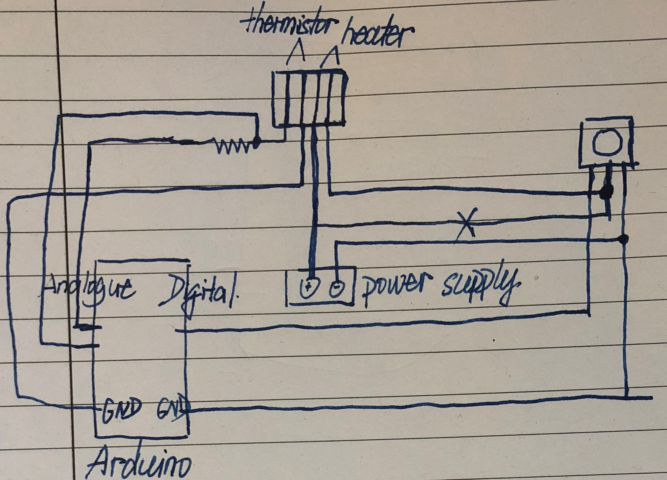
Temperature Control – Heating
12V4A power supply, 3Ω 30W heater and n-type MOSFET
PWM used to control the power through the heater
MOSFET Gate/Drain/Source
Diode used for protection

Slide 11
Temperature Control – data and test results
set 38, stop at set value-0.5C, PWM 160
Specification required us to keep temperature between 25 – 35 °C to within ±0.5°C of the set point
This time we slightly changed the code for thermistor so that there is no need for the offset, and also we connected the right pin to the digital ground on the Arduino. This is essential for the PWM as the signal needs to complete the whole circuit in order to have it function properly.
Measured value /ºC | Actual value /ºC | Difference in Values /ºC | Ammeter reading /mA
36.70 | 37.0 | 0.30 | 1.89
36.70 | 36.9 | 0.20 | 1.90
36.79 | 37.0 | 0.21 | 1.90
36.89 | 37.2 | 0.31 | 1.90
36.98 | 37.2 | 0.22 | 1.90
37.18 | 37.2 | 0.02 | 1.91
37.66 | 37.2 | 0.46 | 0.00
37.86 | 37.5 | 0.36 | 0.00
37.86 | 38.0 | 0.14 | 0.00
Thus we decided to stop 0.4C before the set value.

Slide 12
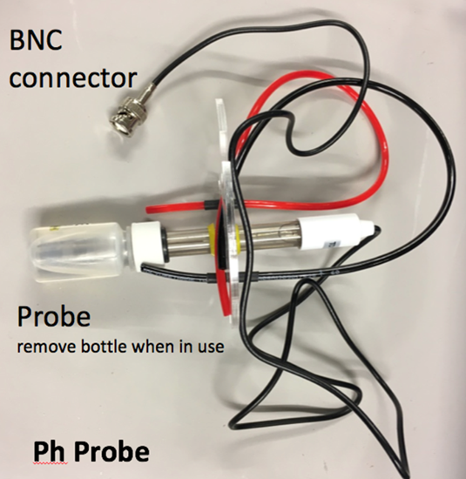
PH System- The pH probe
pH probe was used to detect the pH level of the solution.
The probe produced different voltages depending on the pH
A pH of 0 produced +414 mV, a pH of 7 produced 0 V, and a pH of 14 produced -414 mV.
However, the Arduino is unable to read negative voltages.
Arduino’s voltage range is 0 to 5V.
Specification stated that we should be able to sense pH in a range of 3-7 and maintain an optimum of 5.

Slide 13
pH system- pH Probe circuit
The circuit on the left of the probe adds an offset of 455 mV to the voltage of the pH probe, so its range now becomes 41mV to 869mV, which is readable by the Arduino.
However, due to how little the voltage changes when the pH varies, it is difficult to sense small changes in pH if reading directly from the probe.
Thus, the circuit on the right of the probe amplifies the output voltage range to 0.23V - 4.95V. This makes it more sensitive, as minor changes in pH can more readily be seen by the Arduino.

Slide 14

pH system- Finding out the pH value
Read the voltage, V, of the Circuit
Calculate the voltage across the probe using:
$Vprobe=\frac{V}{Gain}−offset$
Read temperature
Calculate the pH using:
$pH=pH\left(S\right)+\frac{−Vprobe∗F}{R∗t∗ln10}$
Where:
pH(S)=7, i.e. the pH of a standard solution
voltage= (current voltage) / gain - offset
F=96485.309 (Faraday constant)
R=8.314 J/mol (Ideal Gas constant)
t is temperature in Kelvin

Slide 15
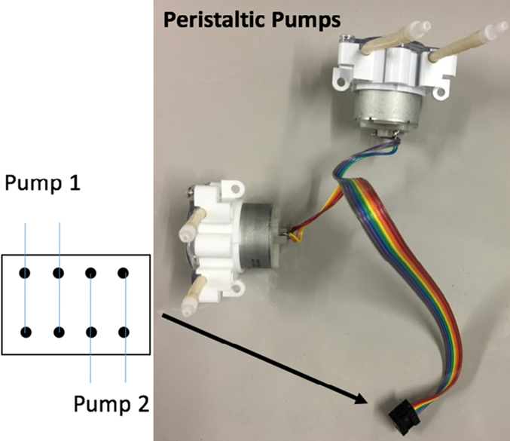
pH system – Peristaltic pumps circuit

Slide 16
pH system – Turning on the pumps
Our ideal pH is between 4.75 and 5.25
If our current pH is less than 4.75 we need to open the pump connected to the basic solution
If our current pH is more than 5.25 we need to open the pump connected to the acidic solution

Slide 17
pH system – Test and results
Measured pH | Actual pH | Difference
15.96 | 4.00 | 11.96
15.97 | 4.74 | 11.23
15.96 | 8.62 | 7.34
4.50 | 4.00 | 0.50
4.25 | 4.25 | 0.00
8.41 | 8.43 | 0.02
8.77 | 8.77 | 0.00
9.77 | 9.77 | 0.00
4.50 | 4.61 | -0.11
3.20 | 3.27 | 0.07
5.15 | 5.10 | -0.05
After these values were obtained,
we investigated what was wrong, and realized that
our pH probe was faulty.
We then replaced the probe and these were observed
*These tests were performed at 25°C

Slide 18
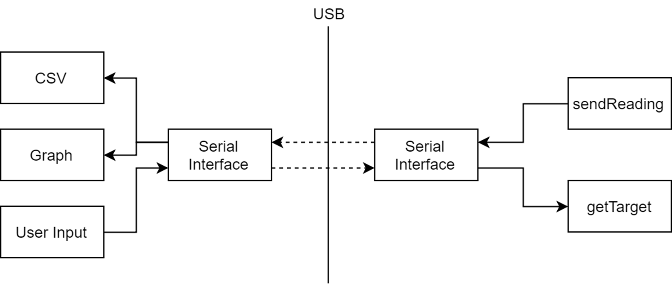
User Interface

Slide 19
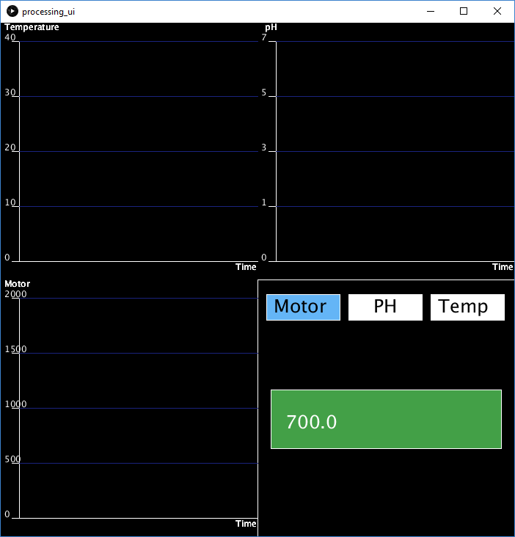
Serial Messages
Text based encoding
SENSOR <millis> <value>
SET <constant> <value>
DEBUG <message>

Slide 20
Questions?

